Slide 1
Home appliances automation using IoT
SMART LOCKS
TEAM MEMBERS:
1.M.AISHWARYA
2.R DEEPIKA
3.T DHIVYAA
4. JASI GRACE I
5. M GOKUL NATH

Slide 2
ABSTRACT
Smart locks are an easy way to increase the security of your home.
The application of smartphone communication technology to conventional device (door lock) to open or close a door remotely through authentication.
The Smart Door Lock System based on security enhancement plan for the safety issue.

Slide 3
TECHNOLOGY
Smart locks use a Bluetooth connection to control the lock, which is accessed through an application on a smart device such as any android or iPhone.
When the registered user approaches the door, the smart lock
Can be opened by detects the Bluetooth signal and unlocks the door by passwords.

Slide 4
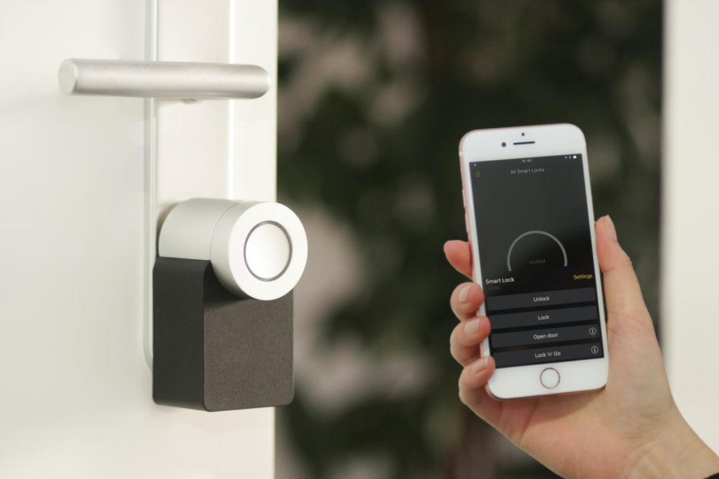
Smart lock

Slide 5
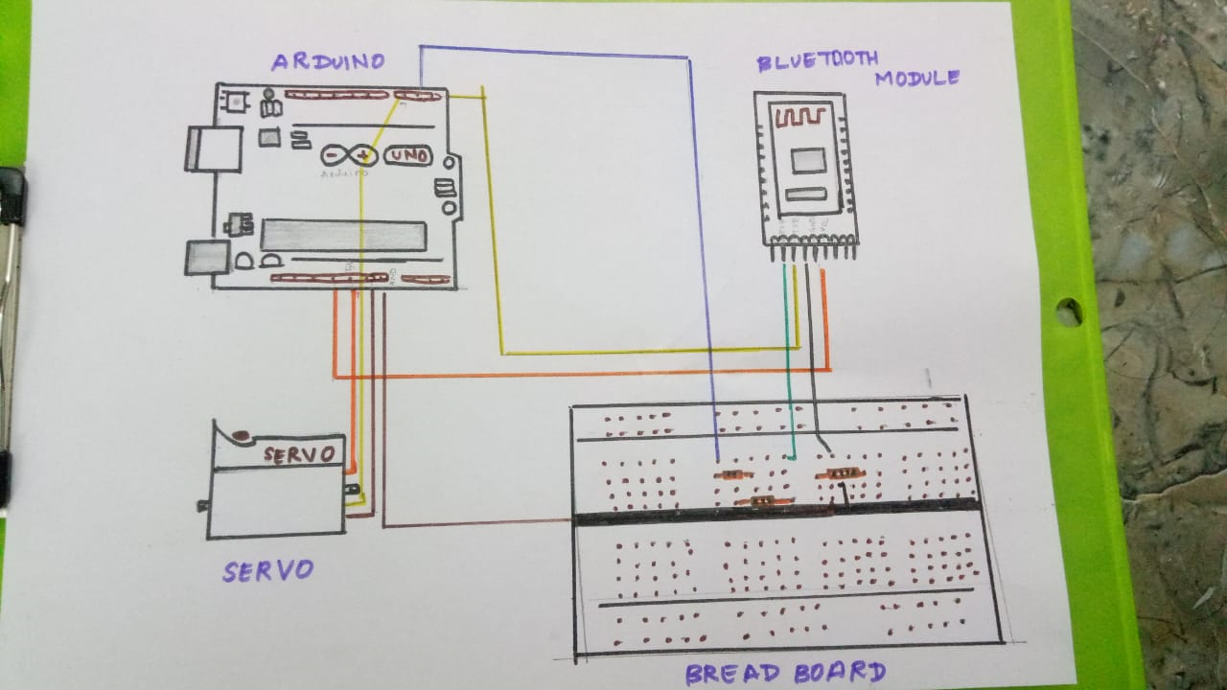

Slide 6
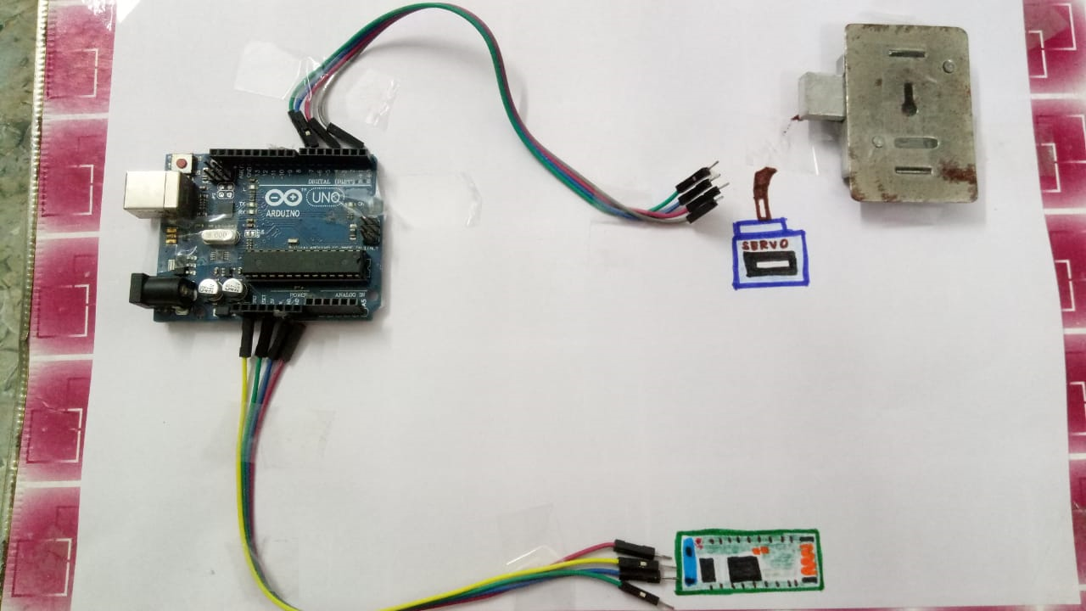

Slide 7
objectives
Our main goal is to make this cost effective
And make the implementation simple
To make our life simple
To enable Camera feauture recording in the lock
To give an alert sound

Slide 8
SAFETY
User only have 3 attempts then an alert msg will be sent to the user.
Each smart lock has its own application, allowing the user to control a wide variety of options.
This this just a extra protection to our normal locks
We can able to see the person outside our home and allow them using our mobile

Slide 9
advantages
Secure and safe
Cost efficient
monitors home all the time
easily handle our home place
extra safe besides our physical lock
the master device has the capability to control temporary devices

Slide 10
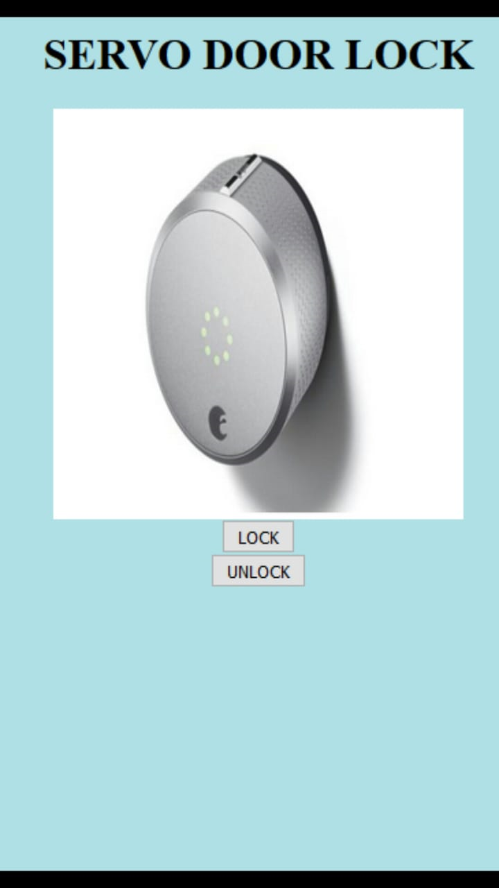
Mobile app

Slide 11
code
<html>
<head></head>
<h1><center> SERVO DOOR LOCK </center></h1>
<body style="background-color:powderblue;">
<center><img src="https://i.pcmag.com/imagery/reviews/05wMIOIlf7b8C0dyvl4M7xP-2.fit_lpad.size_624x364.v_1569479359.jpg" alt="Girl in a jacket" style="width:300px;height:300px;"></center>
<break>
<center> <button type="button"> LOCK </button></center>
<center> <button type="button"> UNLOCK </button></center>
</html>

Slide 12
They work with smartphones.
You can authorize access for multiple people simultaneously.
Some locks enhance security camera functionality.

Slide 13
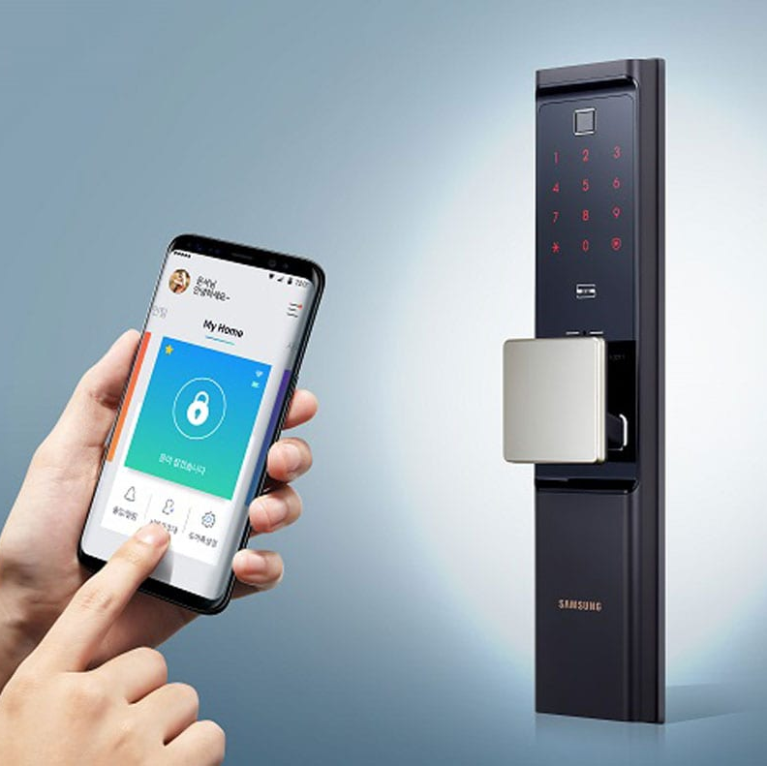
Easily controllable
This will also have an extra password facility for safety purpose

Slide 15
thank you

